Slide 1
Potential Benthic Substrate & Characteristic mapping using multibeam bathymetry & backscatter
April 15th, 2014
CHC 2014, St. John’s
Cassandra Bosma
Canadian Wildlife Service
Environment Canada
Co-op Student

Slide 2
Outline
History of Project
Procedure
Applications & Results
Conclusion
Future Plans

Slide 3
History of Project
Notes:
This presentation will begin with the background and a little bit of the history of the project

Slide 4
Background
2007 - NRCan began collecting data/samples and classifying MBES data in the Scott Islands region of BC (proposed marine National Wildlife Area, EC)
2012 - CHS & EC continued classifying more recently collected data in the same region (Co-op student Stephen Finnis)
2013 - Classification of Gil Island rectangle near Kitimat, BC
2013/2014 – CHS & EC collaborated to collect more MBES data (Rockfish Conservation Area of Scott Islands) and expand classification of the Scott Islands region
Notes:
2007 – NRCan collected a lot of data and samples in the Scott Islands region and determined a classification for the region
2012 – more multibeam data was collected over the years between 2007 and 2012 and classified by Stephen Finnis, who added to the classification work previously conducted by NRCan
2013 – Classification was extended to include the Gil Island rectangle and Douglas channel region leading to Kitimat BC
2013/2014 – More multibeam data was collected in the Scott Islands region by Fisheries and Oceans within the rockfish conservation area of the proposed Scott Islands National Wildlife Area (NWA) and this recent data was classified in 2014 and added to the previously conducted work

Slide 5
Possible Classification schemes
Folk Classification Scheme
Greene Classification
Coastal & Marine Ecological Classification Standard (CMECS)
San Juan Islands Potential Habitat Chart
Notes:
Choosing a classification scheme is a hot topic at the moment and ideally a standardized scheme that can be used everywhere will be utilized so that efforts between organizations can be paired together.
CHS began using a modified FOLK classification scale to categorize sediments circa 1997 (Jim Galloway, meeting Sept 2013)
NRCan also used a modified FOLK scheme for the classification of Cook Bank in the Scott Islands region in 2007 (Finn, 2007)
This classification was continued in 2012 with the more recently collected data for Cook Bank
Greene classification is a detailed benthic habitat classification scheme that was pioneered by a man named Gary Greene and his colleagues in the U.S. and California
It is a detailed scheme that was used in the creation of 4 substrate charts in the San Juan and Gulf Islands region near Victoria BC
It consists of 6 main classes of substrate with many subclasses possible within each when the morphology is also taken into account and extensive surveying and sampling was conducted to get to this level of detail.
If we are to use this scheme we will be using on the main substrate classes only until such a time that we can commit to thoroughly analyzing the area in further detail such as with the San Juan Islands example.
is also useful for the scale of multibeam data that we will be handling
The U.S. is shifting towards a Coastal and Marine Ecological Classification Standard (CMECS) that is a US national standard and does not just apply to the Pacific. CMECS also has a strong basis in the Greene model of classification and shares many of the same elements.
In the interests of standardizing we may follow the US’s example. It is an effective model for the scale of multibeam data that we will be handling and the level of detail we may want to pursue in the future.
Full habitat model is not pursued yet because it would require extensive and time consuming analysis

Slide 6
Procedure
Analyzing potential substrates from backscatter
Notes:
The classification process works by analyzing the bathymetry and more importantly, the information obtained from the backscatter

Slide 7
Backscatter
Returning signal intensity varies depending on the kind of material the signal hits and reflects
High intensity:
Hard Substance - Rock or gravel
Low intensity:
Soft Substance - Mud, silt, sand, etc.
Scott Islands, BC Backscatter
5m grid cell size
Notes:
The Multibeam data is collected from Echosounders that use an acoustic signal. The time it takes for a sent acoustic signal to reach the bottom and return corresponds to the depth. The strength of the returning signal is the backscatter and can relate to the benthic substrate.
High intensity is shown by the lighter areas in this image and correspond to hard substances such as rocks, boulders, gravel, cobbles etc.
Low intensity is shown by the darker areas and is related to soft substrates such as mud, silt, sand, etc.

Slide 8
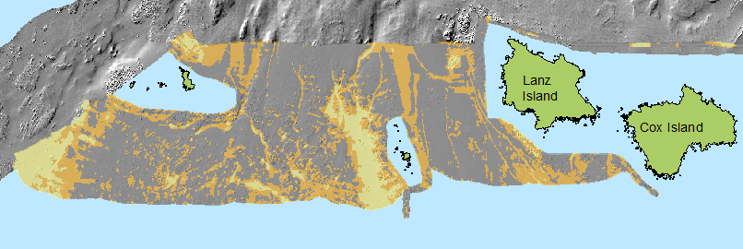
‘Unsupervised’ Procedure for Sediment classification
Acquire processed bathymetry and backscatter data sets - Smooth and filter backscatter
Cluster backscatter based on statistical breaks in the backscatter mosaic -Number of clusters determined by preliminary studies, or trial-and-error to find meaningful groups
Generalize/Clean the data clusters with neighbourhood statistics
- Clustering without rock layer
Notes:
This is an ‘unsupervised’ method that can be used in regions without adequate sampling to make maps of large regions and is done with ArcGIS version 10.1 with spatial analyst extension.
(unsupervised basically means that there is no data dictionary or reference for how the zones are clustered and created. Supervised usually is completed with bottom samples and other information to reference with backscatter)
First the processed bathymetry and backscatter data sets are smoothed and filtered with neighbourhood statistics
Next, the backscatter is clustered based on statistical breaks in the intensity data, grouping areas of similar intensity together.
The number of classes chosen in the cluster stage is dictated by the user and can depend on the region, the quality of the data, and the chosen classification scheme. The numbers of cluster classes can also be determined by preliminary study of the area that determines the likely number of classes necessary to characterize the region.
After the clustering is completed it is then cleaned and generalized with more neighbourhood statistics

Slide 9
Rock layer
Rock is not differentiated from other ‘hard’ sediment classes using the cluster method
Extract rock from bathymetry using slope, neighbourhood statistics and modified terrain complexity (rugosity)
This method finds areas with greater terrain variation compared with neighbouring cells
Add rock layer into sediment classes
Notes:
(This method is not currently able to separate boulders, large rocks, rockfalls, etc. from bedrock - All rock is one classification)
Areas of rock such as bedrock and boulders are not differentiated from other hard substances adequately and must be extracted from the bathymetry.
The image on the left shows the clusters overlaid over a hillshaded relief and it is apparent that the rough rock region is classified along with the rest of the hard substrates in the same cluster.
The rock is extracted from the rest of the substrate using the bathymetry slope and a modified rugosity to find areas with greater terrain variation than it’s neighbouring cells.
This is then added to the substrate cluster layer and creates an image like the one shown in the right. The rock now stands alone as it’s own class.

Slide 10
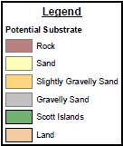
Finished potential substrate map
Scott Islands BC
Vancouver Island
Next - Build accompanying characterized layers for slope, depth, morphology, etc.
Notes:
Using a suite of tools in ESRI’s ArcMap, the backscatter is transformed and classified into potential substrate categories.
They are labeled as potential because the classes are unverified and the method is unsupervised.
This image represents the completed potential substrate classification of the Scott Islands region in BC
The 3 classes chosen (plus the rock) were based on a previous classification done by NRCan in 2007. Through grab samples and sediment cores, NRCan determined that 4 main sediment types were identified in the Cook Bank region (in the northeast sector of the survey). This information was used to determine the most common broad scale sediment classes in the backscatter.
More characterizations to compliment the substrate layers are possible using the bathymetry

Slide 11
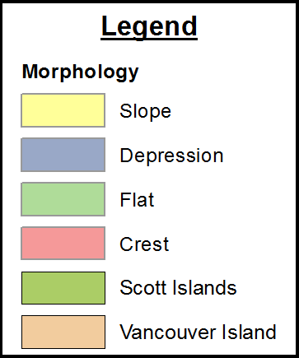
Morphology
Use Benthic Terrain Modelling (BTM) Toolbox developed by NOAA
Build Bathymetric Position Index (BPI – much like Topographic Position Index, TPI, for land) and classify into broad benthic zones
Notes:
Morphology is produced using a GIS tool from the NOAA collectively called the Benthic Terrain Modeller (BTM).
This application of the Benthic Terrain Modeller (BTM) gives an overview of the morphology of a region classifying the bathymetry into broad benthic regions indicating shallow crests, depressions and differentiating slopes from flats.
The tool uses a bathymetric position index, similar to a land based topographic position index, to determine the zones.
Knowing the morphology of a region aids in habitat differentiation
Relative topographic position (also called the Topographic Position Index) is a terrain ruggedness metric and a local elevation index (Jenness, 2002). Topographic position of each pixel is identified with respect to its local neighborhood, thus its relative position. The index is useful for identifying landscape patterns and boundaries that may correspond with rock type, dominant geomorphic process, soil characteristics, vegetation, or air drainage. Classify results into high, medium, low based on natural breaks. The index is applicable to bathymetric data, too (see refs).

Slide 12
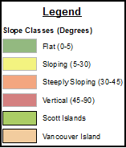
Slope
Slope ranges are flexible and can be determined based on user defined ranges from the bathymetry data
Notes:
Slope is determined using a tool in ArcGIS using the bathymetry.
These slope classes are based on those ranges suggested by the Greene model (1999) but are completely flexible and customizable depending on the intended use for the data, the region, and the classification scheme chosen.
(Reference - Greene, H.G., Yoklavich, M., Starr R., O’Connell, V., Wakefield, W., Sullivan, D., Mcrea, J., & Caillet, G., (1999). A classification scheme for deep seafloor habitats. Oceanologica Acta, 22.6, 663-678)

Slide 13
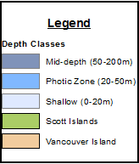
Depth
Depth ranges are flexible and can be determined based on user defined ranges from the bathymetry data
Notes:
The depth from the bathymetry can also be classified into zones.
The chosen depth classes displayed in the image are based on the BC marine ecological classification ranges. Any range of depth values according to any scheme or usage can be chosen to express the classes, it is completely flexible and can be customized numerous ways.
The shallow areas are unable to be accessed by the larger survey ships, especially given the environmental conditions in this region. As such, much of the shallower ranges in this scheme are not represented.

Slide 14
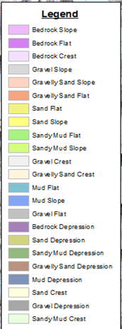
Layer combinations
Possible database of polygons or rasters for:
-overlaying -querying -combining
In order to answer habitat questions
Substrate & Morphology
Notes:
If the purpose of the files only requires overlaying two layers, they can be combined for better display to further characterize an area.
This example is of Whale Channel off the East coast of Gil Island and links to Douglas Channel and Kitimat BC region and combines the substrate and morphology into areas of potential habitats but any combinations of characterized files is possible.
Eventually we can build an extensive database of files that can be overlaid, combined, or queried in order to answer habitat questions.
The querying can be used to locate specific habitat such as shallow, steeply sloping, rocky areas, or deep mud flats.
This is where the potential to be highly useful for habitat mapping is revealed.

Slide 15
applications
Current & Future
Notes:
(How do we intend to use this technique?)
We have already begun applying this method to a few practical applications on the Pacific coast

Slide 16
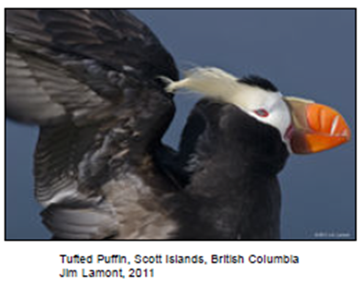
Possible uses
Seafloor classification
Provide base layers for habitat mapping - Supporting World Class Response
Locating potential forage sites for seabirds (Pacific Sand Lance habitat)
Locating potential habitat for specific marine biota (Rockfish, etc.)
Potential to contribute to Pacific Marine Ecological Classification (PMECS) - Federal-Provincial government Marine Protected Areas Implementation Team
Notes:
Possible uses include seafloor classification and providing base layers for habitat mapping and possibly locating key habitat areas for marine species. Of particular interest are those that have the potential to be forage sites for seabirds. (- Cliff Robinson, Doug Bertram, Stephane Gauthier)
There is also the potential to contribute to the Pacific Marine Ecological Classification initiative for identifying potential candidates for marine protected areas.
(Support habitat mapping
Seafloor classification
Identify potential seabird foraging sites
Identify Rockfish and Pacific Sand Lance habitat (forage fish species)
Potentially aid in paleomorphology reconstructions for the past ice age
PMECS supporting identification of potential new marine protected areas candidates)

Slide 17
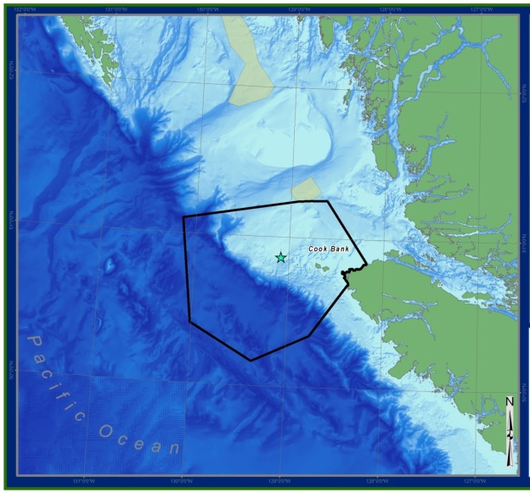
Scott Islands Proposed marine National Wildlife Area Characterization
Support management decisions regarding the proposed area and aid in research
Notes:
Potential substrate was determined from surveyed zones within the boundary of the proposed Scott Islands marine National Wildlife Area off the north coast of Vancouver Island.
This area has been deemed significant for a number of seabird species.
The boundary of the NWA is set to encompass important areas for the seabirds such as nesting sites and forage ground on and off of the continental shelf. Not only will it benefit the birds, but also any other marine wildlife in the region.
The characterized substrate layers here will be used to support management decisions regarding the NWA as well as aid in marine research.
(Support habitat mapping
Seafloor classification
Identify potential seabird foraging sites
Identify Rockfish and Pacific Sand Lance habitat (forage fish species)
Potentially aid in paleomorphology reconstructions for the past ice age)

Slide 18
Support Habitat Mapping –Fisheries and Oceans Canada Canadian Hydrographic Service
Completed Substrate Classification -North Central Coast BC
Notes:
Another region mapped and classified is the network of deep channels leading to Kitimat on the North central coast of BC
This classification is hoped to support habitat mapping for World Class Response for oil tanker spills in the ocean.
The inset map is a magnified region of whale channel. The points overlaid on top of the potential substrate classification are from a sediment analysis performed by another software program from CARIS called HIPS and SIPS.
The program performs an analysis with points of intensity within the backscatter and assigns the point a sediment class based on a built in range of classes corresponding to sediment grain ranges.
When the sediment analysis points determined by CARIS are overlaid onto the cluster analysis performed in ArcMap, it seems as if many of the classes agree with the sediment point assigned by CARIS. Many of the gravel points are located in gravel highest intensity cluster and muds and clay points are located in the lowest intensity cluster. This lends to more confidence in this method that the two separate software packages classify the backscatter into similar ranges.
(Habitat mapping (especially at depths beyond SCUBA and ROV)
Seafloor classification
Navigation)

Slide 19
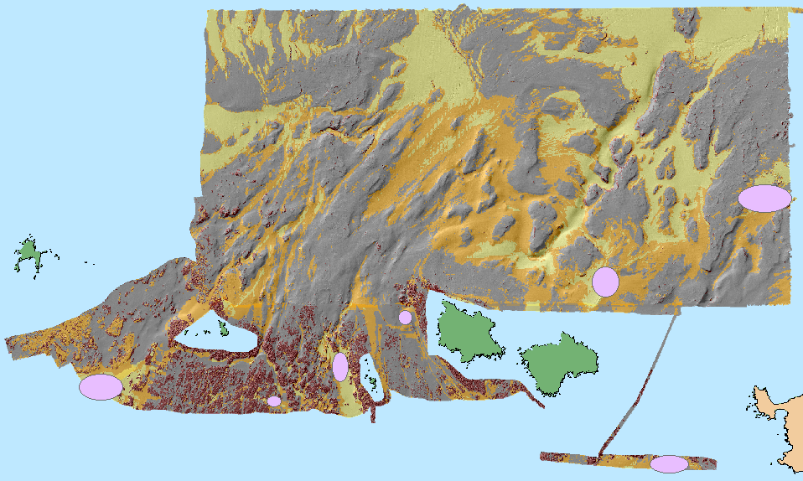
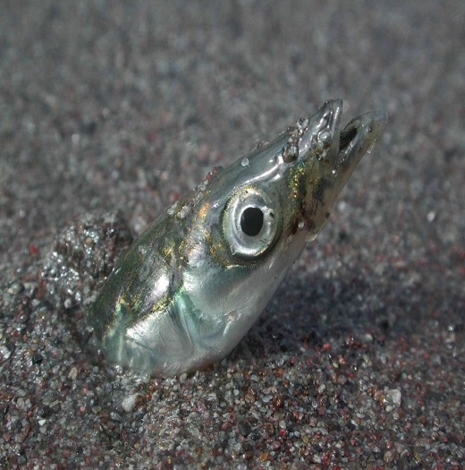
Sand Waves & Pacific Sand Lance (Ammodytes hexapterus) Habitat
The pink ovals represent areas where potential sand waves have been located
Sand waves are associated with Pacific Sand Lance, a forage fish species
Notes:
Sand Lance are a forage fish species and locating their habitat benefits seabirds immensely. Knowing where the birds feed is significant to designing conservation efforts.
Sand Lance require sandy waves, and the right type of fine ‘fluffy’ sand is important to their preferred habitat
Using this classification method we can determine where potential sand is located and the areas that correspond to wavy potentially sandy sediment bedforms.
This image of the Scott Islands shows potential sand waves indicated by the pink ovals.
While the hydrographic data was being collected in this region during 2013 a large number of sea birds were observed feeding on the surface of the ocean at the location west of Beresford Island. This location is where one of the suspected sandy sediment bedforms is located. With this information from the backscatter it is possible to more efficiently design future surveys for bottom sampling and even pelagic bird surveys.
This method is beneficial to identify sand lance in particular because they are unique among forage fish in that they do not have a swim bladder and that they burrow in the substrate, unlike other species such as herring. Because of these aspects of Pacific Sand Lance they are difficult to detect using acoustic methods and therefore locating potential habitats using backscatter analysis is a promising technique to study this species.
There is a project being conducted in BC where a team of researchers (Cliff Robinson, Doug Bertram, Stephane Gauthier) are looking to validate backscatter around suspected pacific sand lance habitat by detecting the actual fish and studying the bottom habitat. One of the goals of this research is to identify a specific backscatter signature for ideal sand lance sand.

Slide 20
results
Preliminary Verifications
Notes:
So far we have not been able to conduct extensive ground-truthing, but we do have some results from preliminary verifications.

Slide 21
Preliminary verifications
NRCan 2007 - completed bottom sampling and correlation in the northeast corner of the surveyed region
65% correlation with grab sample
75% correlation with sediment core
(Unpublished report – Finn, 2007)
Notes:
The Scott Islands has a high density of samples, many collected by NRCan in 2007. (The samples were collected using a variety of different grabs, cores and some are from older lead line data.)
So far the only correlation studies between field samples and the computer generated classification were done by NRCan in 2007 in the northeast sector of the surveyed area.
A 65% correlation of backscatter classification to grab sample and 75% correlation with sediment cores. (Some finer sediments were suspected to have been lost from the grab samples on the way to the surface). (Finn, 2007)
We will be continuing this in the more recently surveyed areas soon as well as looking for potential future sampling locations.

Slide 22
Edge matching
Surveys completed over several years with different equipment
Classification done by different people using similar but slightly different parameters
Edges naturally aligned with matching classification between the surveys
Notes:
When two surveys are put together the have corresponding edges. In the Scott Islands the edges are not an exact match but it is a credible match considering the differing variables between surveys such as equipment, vessels, and the persons analysing and completing the classification.
In this case the edges of the 2012 (upper) and 2014 (lower) classifications naturally aligned without any manipulation of the data at the edges to force the edges to match better.
(it is promising
No “tweaking” of the data to make the edges match better
Separate surveys, equipment, hydrographers, and geomatics technicians analyzing the data still produced similar results)

Slide 23
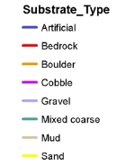
Preliminary underwater ROV Comparison
ROV transects in the Scott Islands are overlaid onto substrate layer
An analysis of correlation is ongoing and preliminary visual comparisons are promising
ROV Credit: Lynne Yamanaka; Pacific Biological Station; Nanaimo; Department of Fisheries and Oceans
Notes:
Approximately 23 ROV transects for rockfish habitat research were conducted by Fisheries and Oceans throughout the Scott Islands region in 2011.
These transects were overlaid onto the substrate classification shown by the red lines in the right image. The data is newly acquired and so correlation is ongoing but the preliminary visual comparison is promising. Much of the hard substrate in the classification corresponds to where rock, boulders, gravel and cobbles were viewed in the ROV and the slightly softer substrate relates to sandy gravels.
These preliminary comparisons to ground truth show promising results and this method can be used to determine future surveys, sampling locations and can help with management decisions.

Slide 24
Conclusions
& Future plans
Notes:
What can we conclude from these results?

Slide 25
Conclusions
Shows potential for habitat mapping and as a management decision making tool
Can differentiate minor changes not discernable to the human eye as with manual backscatter classification
Adequate method for complete coverage classifying large data sets
Repeatable and with reasonably rapid results
Needs verification
Notes:
We can conclude that there is a lot of potential for effectively mapping large areas of benthic habitat in a reasonable amount of time and it is a more accurate way to classify backscatter than manual segmentation by eye. Manual segmentation cannot distinguish minor variations in backscatter intensity that are indiscernible to the human eye where as this mapping method using GIS tools can.
It is useful for aiding in management decisions regarding surveyed and classified areas and can assist with the locating of sampling locations for things like pelagic bird surveys, video ROV transects, dive surveys and grab samples.

Slide 26
Recommendations
Ground-truth with adequate sample sizes to obtain coverage of all potential substrate types
Coordinate with national & international partners for standardization (GeoHab working group)
Collect more data in shallow and near-shore waters (GeoSwath in Gwaii Haanas)
Support GIS - build and manage a database for characterized layers
Expand coverage of classification
Compare with LIDAR and create similar process with LIDAR data (Collaboration with Trent University)
Notes:
Dave: I skipped this one, but you can add it in to the slideshow and adjust it if you need to.

Slide 27
Future Plans
Ground-truth (2014) - Sediment grabs, cores and video transects (planned & opportunistic)
Identify possible Pacific Sand Lance (Ammodytes hexapterus) habitat signature in backscatter and extrapolate to find habitat throughout Pacific coast in support of seabird research (Cliff Robinson, Stephane Gauthier, Doug Bertram)
Ongoing classification of existing MBES data and collection of more during future surveys
Notes:
Some of the future plans regarding this project include ground-truthing that will occur in 2014 with planned and opportunistic sampling using grabs, cores, and video among other techniques.
Pacific Sand Lance study will be underway shortly to identify the Backscatter habitat signature for ideal sand lance sand, and apply this to the rest of the BC coast. (Robinson, Bertram, Gauthier)
And classification of priority regions is ongoing and more data will be collected and classified in future surveys
(- Possible Free Fall Cone Penetrometer(FFCPT), NRCan, Gwyn Lintern, Douglas Channel - Sediment grabs, cores and video transects (planned & opportunistic) )

Slide 28
Data Sources, Technical support & Software
Data Sources & Technical Support
- CHS - NRCan - CWS
Software - Fledermaus Geocoder Toolbox V 7.3 - CARIS HIPS & SIPS V 8.1 - ArcGIS V. 10.1with Spatial Analyst - Benthic Terrain Modeller (BTM) Toolbox (NOAA)
Notes:
Skip this one. I was going to delete it but then I thought that having the information might be good to have on hand if anyone wants to know which software packages and versions were used to create the examples.

Slide 29
Acknowledgements
Discussion questions?
David Dodd, Kalman Czotter, Dave Jackson, Greg Jones, Doug Bertram, Vaughn Barrie, Robert Kung, Lynne Yamanaka, Stephen Finnis
The Canadian Wildlife Service, Environment Canada, Canadian Hydrographic Service, Fisheries and Oceans Canada, Natural Resources Canada
For valuable contributions and support
Notes:
This concludes the presentation! ☺

